Slide 1
ALT
(24ALT3101)
Explainable AI Framework for Spam SMS Detection Using Transformers
Group: 15
Sec: 07
2420030044 - U. Jaya Sindhura
2420030376 - K. Ushasri
2420030583 - P. Smitha

Slide 2

Introduction
SMS spam is increasing rapidly.
Spam messages cause financial loss and privacy issues.
Existing models cannot explain their predictions.
BERT understands the context of messages better than traditional methods.
Explainable AI improves transparency and user trust.

Slide 3
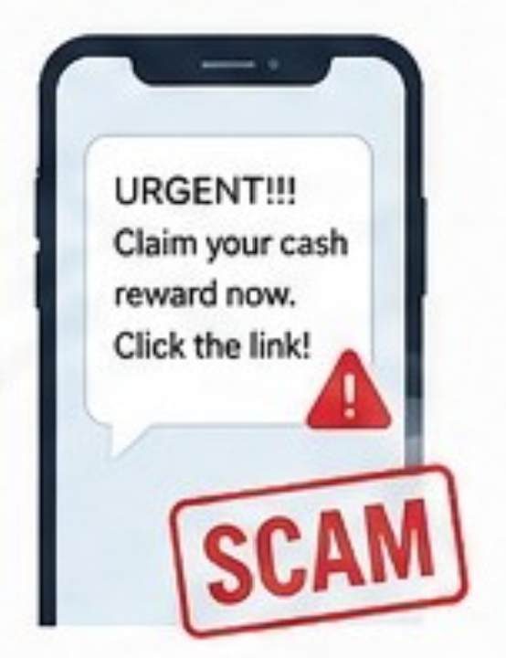
Problem Statement
Spam SMS messages are increasing rapidly.
They are commonly used for fraud, phishing, and unwanted advertisements.
Traditional ML models have limited contextual understanding.
Existing models often do not explain their predictions.
Users need a detection system that is both accurate and explainable.

Slide 4

Objectives
To develop a BERT-based SMS spam detection system.
To classify messages as Spam or Ham.
To improve contextual understanding of SMS messages.
To use SHAP and LIME for explaining predictions.
To provide confidence scores and human-readable explanations.
To evaluate the model using Accuracy, Precision, Recall, and F1-Score.

Slide 5
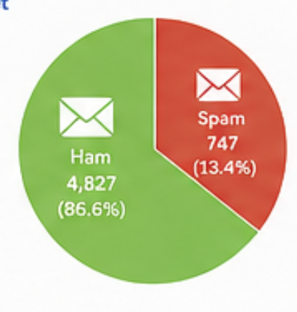
DataSet
SMS Spam Collection Dataset
Contains 5,574 SMS messages.
Two classes: Spam and Ham.
Used for training and testing the model.
Suitable for text classification and spam detection.
BERT will be fine-tuned using the dataset.
You can mention:
Source: Kaggle – SMS Spam Collection Dataset
SMS Spam Collection Dataset : https://www.kaggle.com/datasets/uciml/sms-spam-collection-dataset

Slide 6
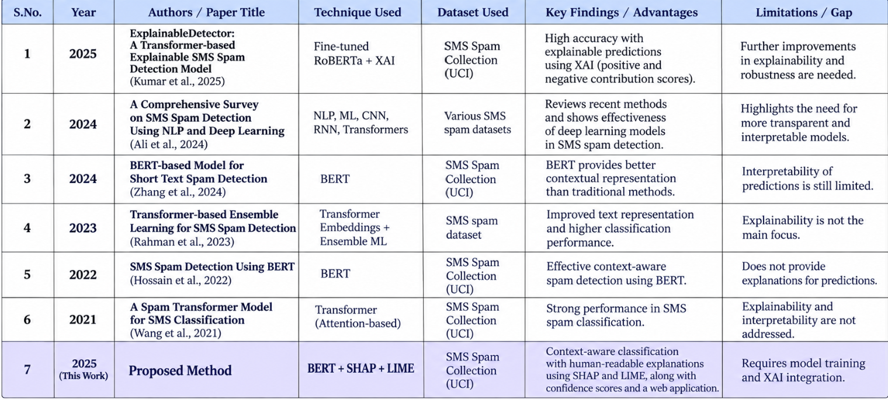
Literature Survey

Slide 7
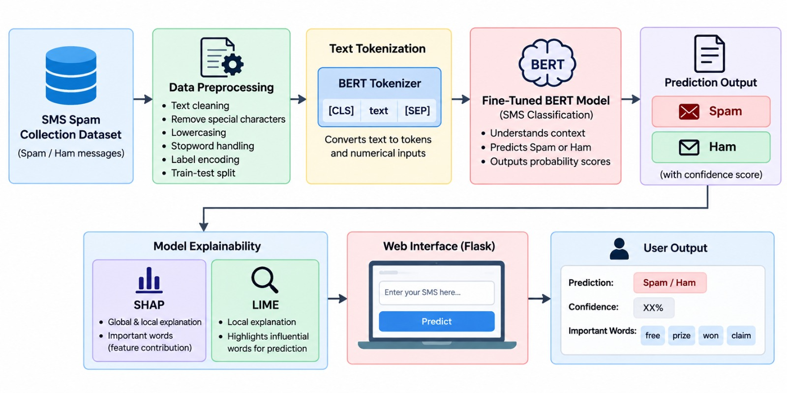
System Architecture

Slide 8
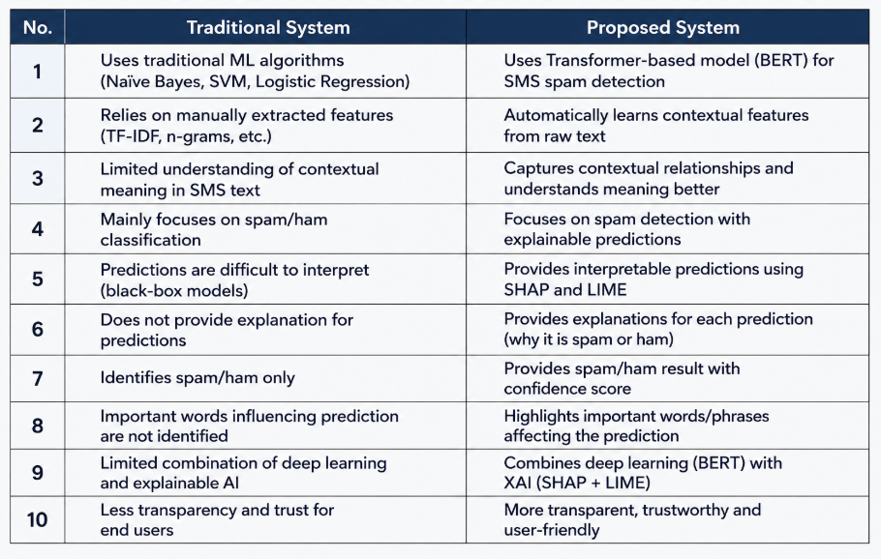
Research Gap Identification

Slide 9

Innovation
Combines BERT + Explainable AI.
Uses SHAP and LIME for prediction explanation.
Identifies important words influencing classification.
Provides both prediction and confidence score.
Makes AI-based spam detection more transparent.

Slide 10
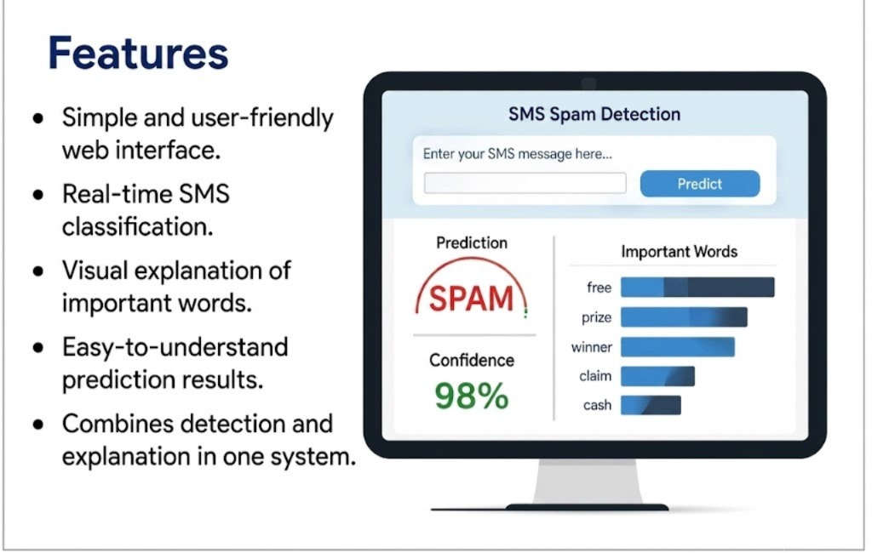
Creativity

Slide 11
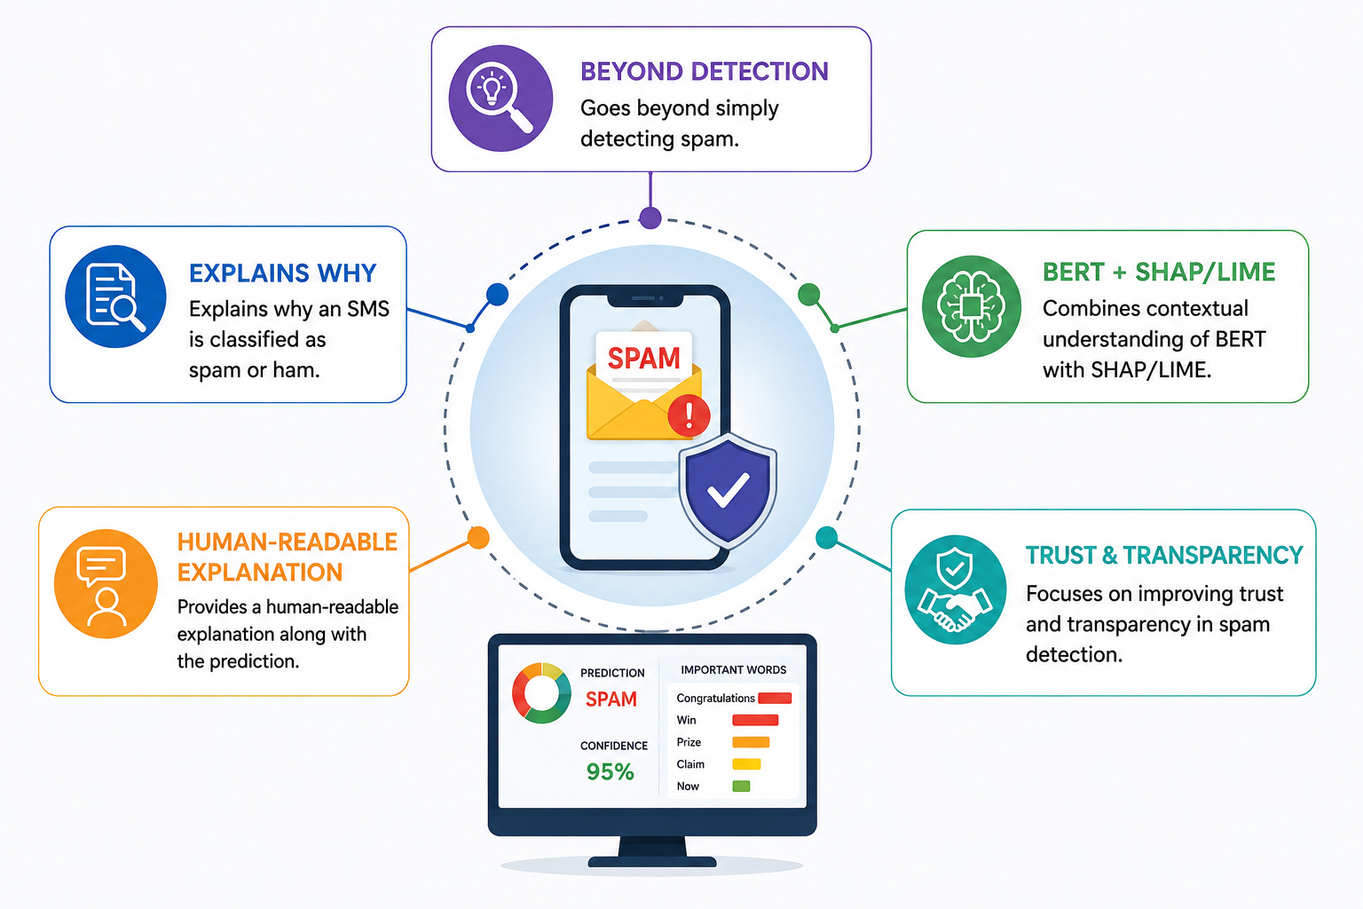
Novelty

Slide 12
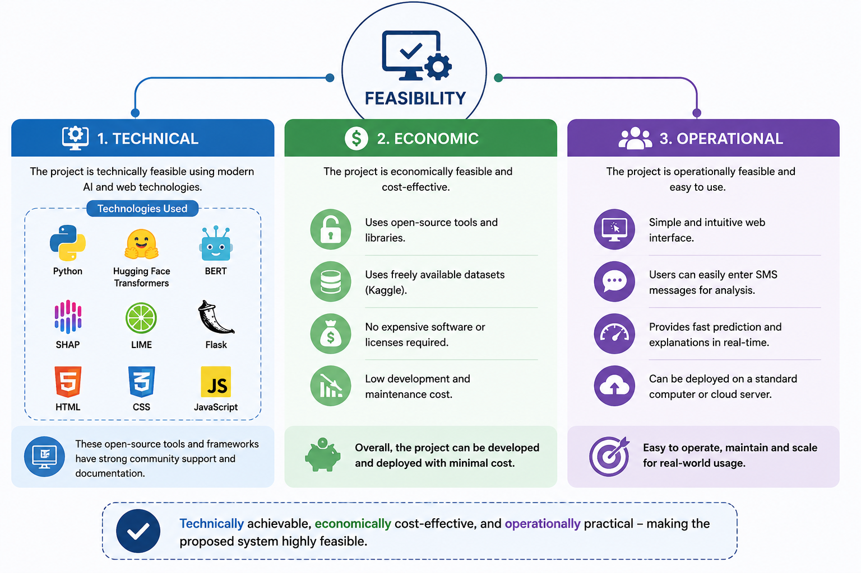
Feasibility

Slide 13
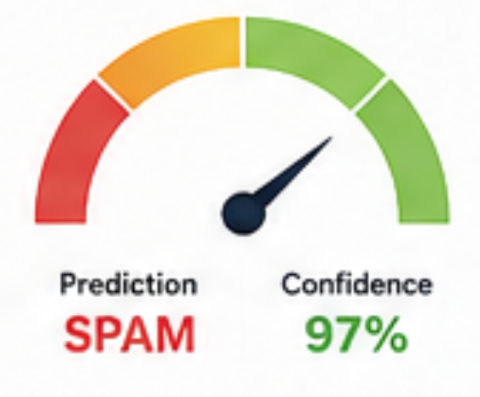
Result
Spam/Ham classification using BERT
Improved contextual understanding
Confidence score for predictions
Important words highlighted using SHAP/LIME
Human-readable explanations
User-friendly web interface
Evaluation using Accuracy, Precision, Recall & F1-Score
Improved transparency and trust

Slide 14
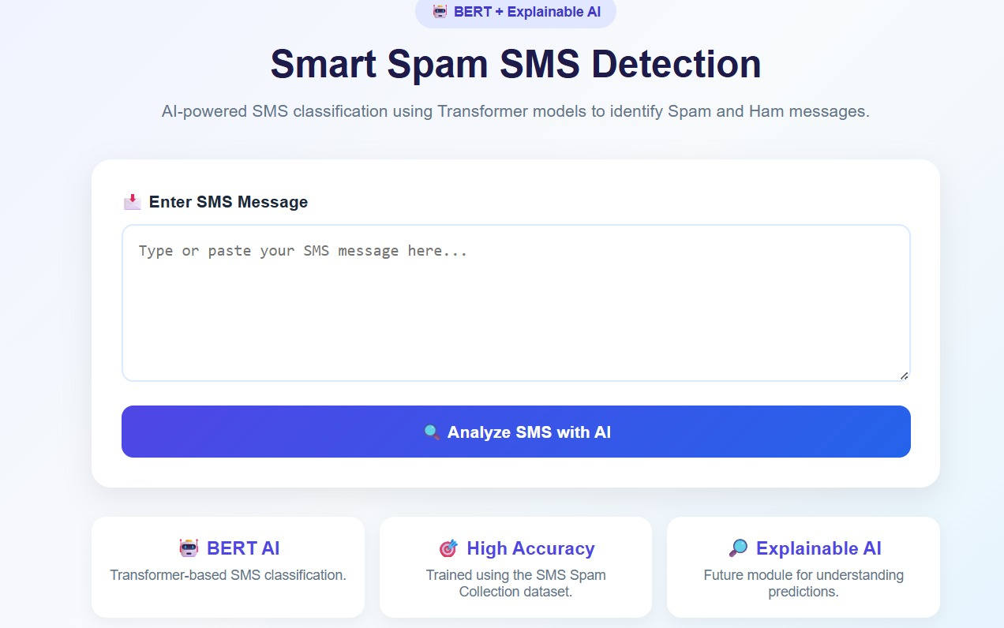
Result

Slide 15
Thank you

